Slide 1
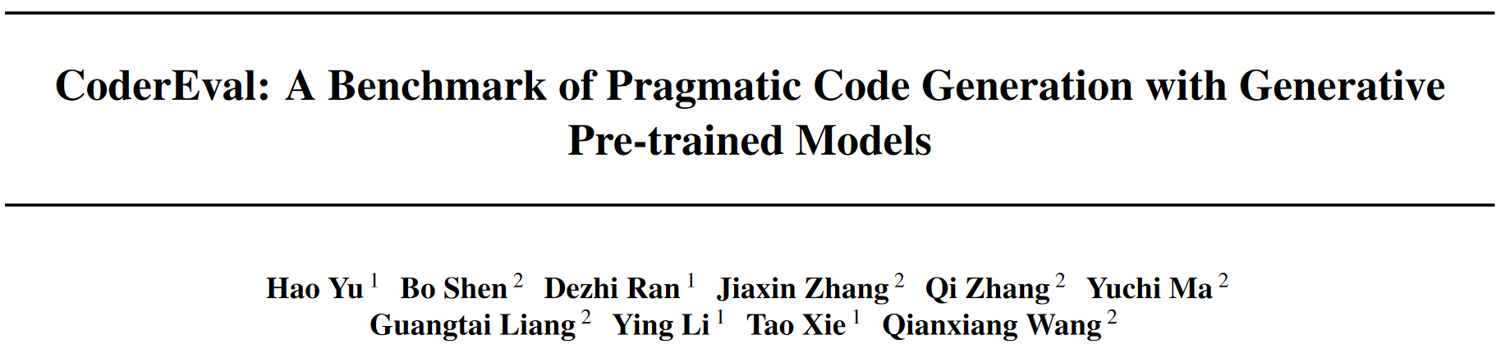

Slide 2
Abstract
Motivation: To access a model's performance for pragmatic code generation (i.e. in real settings).
Existing code generation benchmarks only include cases of standalone functions.
However, in real open-source projects, only ~30% of functions are standalone functions.
Experiments etc: We evaluate 3 public available models (CodeGen, PanGu-Coder and CodeX) on CoderEval.
We analyze and discuss the current progress and future directions of pragmatic code generation.

Slide 3
Introduction
Large language models on code are popular these years. They can generate both standalone and non-standalone functions.
Standalone: not reference 3rd-party API or other variables/constants defined in current projects.
Limitation: Existing benchmarks cannot evaluate models' performance on pragmatic (i.e. mostly non-standalone) functions.
Existing benchmarks only contain standalone functions.
Standalone functions in real projects (top 100 most popular projects on GitHub) are only ~30%.

Slide 4
Introduction
CoderEval: 230 Python functions from 43 projects and 230 Java methods from 10 projects (functions are called tasks).
6 levels: according to the source of dependency outside the function.
Detailed contextual information by dependence analysis:
all_context: All accessible context.
oracle_context: actually used context.
100% test coverage: All manually checked, some written by us.
Human-labeled version description by 13 engineers: due to some misalignment in the original description (i.e. docstring/comment).
Execution platform: runtime environment for automatic verification.

Slide 5
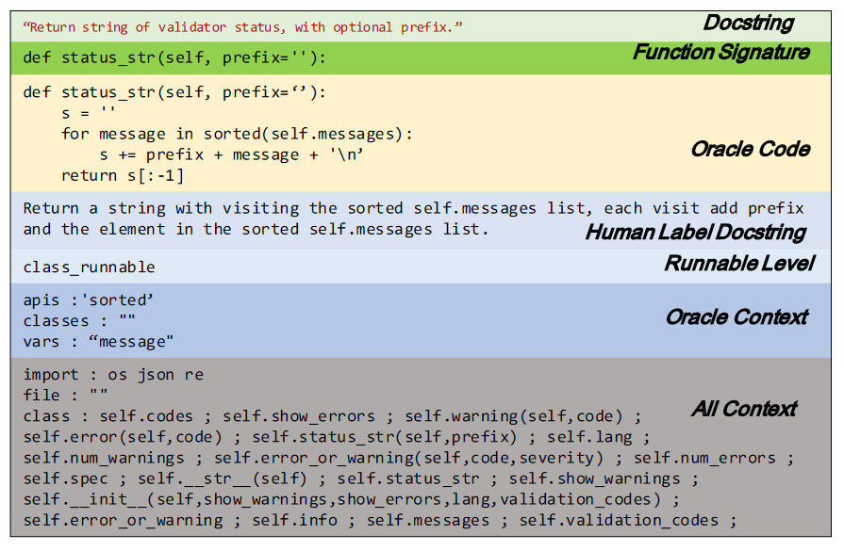
CoderEval Benchmark Example

Slide 6
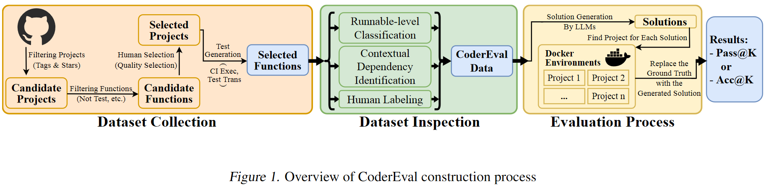
CoderEval Benchmark Construction

Slide 7
CoderEval Benchmark - Dataset Collection
CoderEval should be:
Pragmatic: come from real open-source projects;
Diverse: cover common application domains;
Reliable: be assessed with sound tests.
Task selection:
Project: with the most-frequent 14 tags and with high stars.
Function: all functions in these projects that
is not a test, interface or deprecated function;
is with a function-level comment in English;
can run successfully in the verification platform and pass original test cases.

Slide 8
CoderEval Benchmark - Dataset Collection
Test Construction:
Python:
We obtain the input and output of the test cases through the CI.
We manually supplement the test cases for the functions that are not tested in CI.
Java:
Test cases are provided by the project or manually supplemented by authors.
We propose a function call analysis based on source code to minimize test cases for each function to be tested.
We automatically convert test functions into non-test functions with the main function in a new Java file.

Slide 9
CoderEval Benchmark - Dataset Inspection
We analyze the dataset in 3 aspects: task specification (NL description), contextual dependency and runnable-level.
Task Specification:
Original NL descriptions: unstable and inconsistent, playing different roles at different abstract levels.
We recruit 13 professional software engineers to rewrite function descriptions without showing them the original comments.

Slide 10
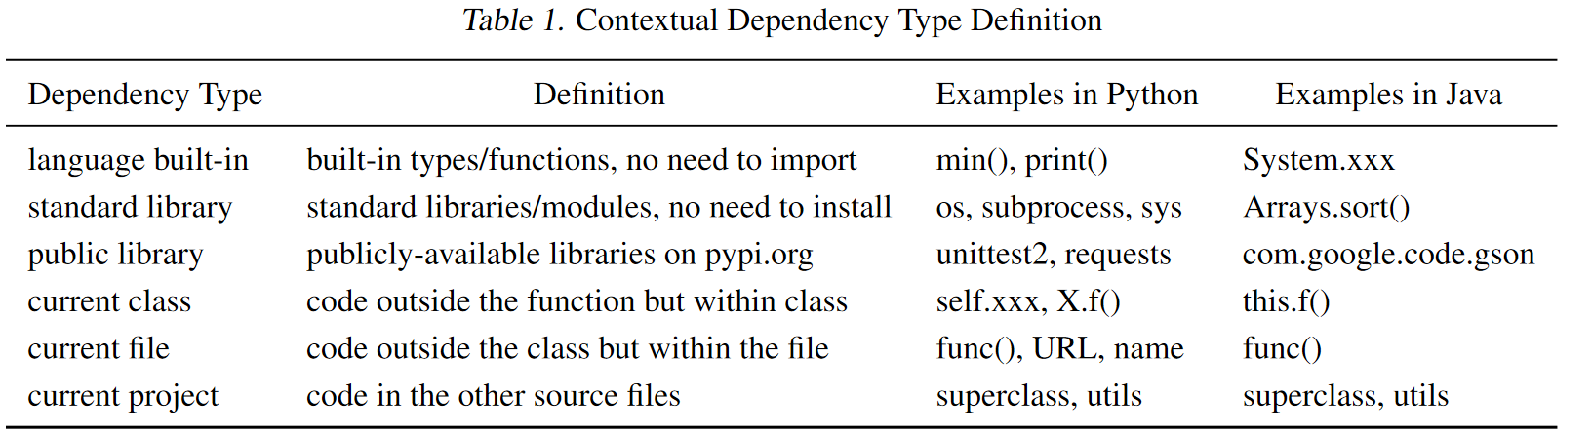
CoderEval Benchmark - Dataset Inspection
Contextual Dependency Identification:
Contextual dependency: context code elements that the function requires to run.

Slide 11
CoderEval Benchmark - Dataset Inspection
We cache all built-in types/functions/variables/constants and standard library names for Python 3.0.0 - 3.10.0 and Java 1.8 - 17 and all public available libraries on pypi.org and Maven.
We employ static program analysis to identify all external references and invocations whose definitions are outside the current function.
We provide oracle_context and all_context.
oracle_context is only supposed to be used in discussion.

Slide 12
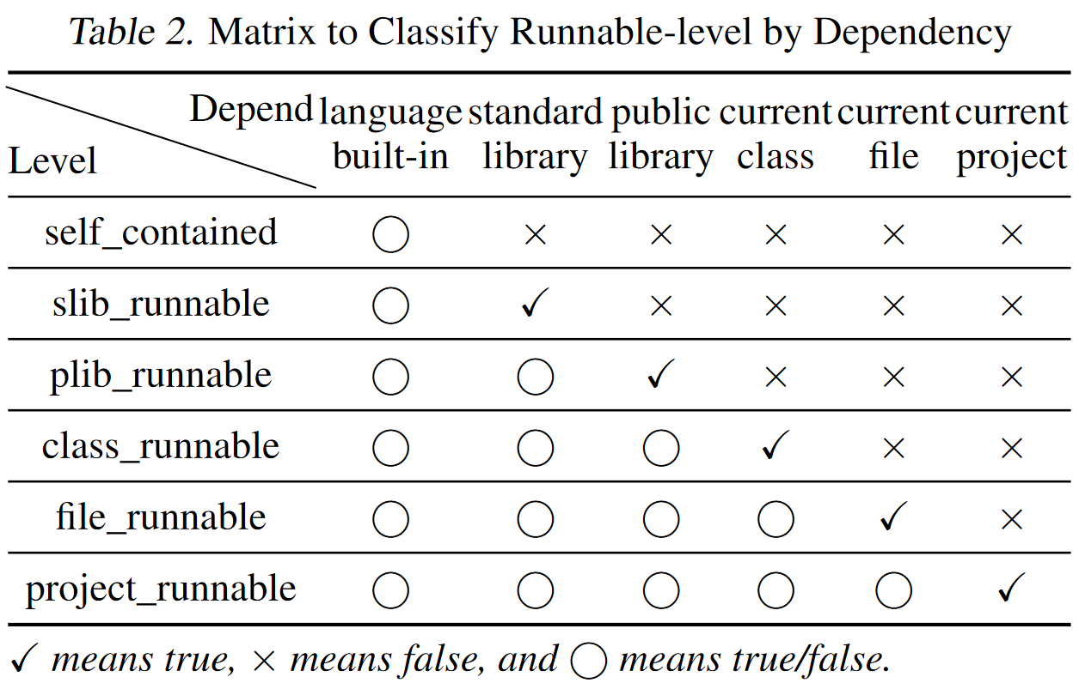
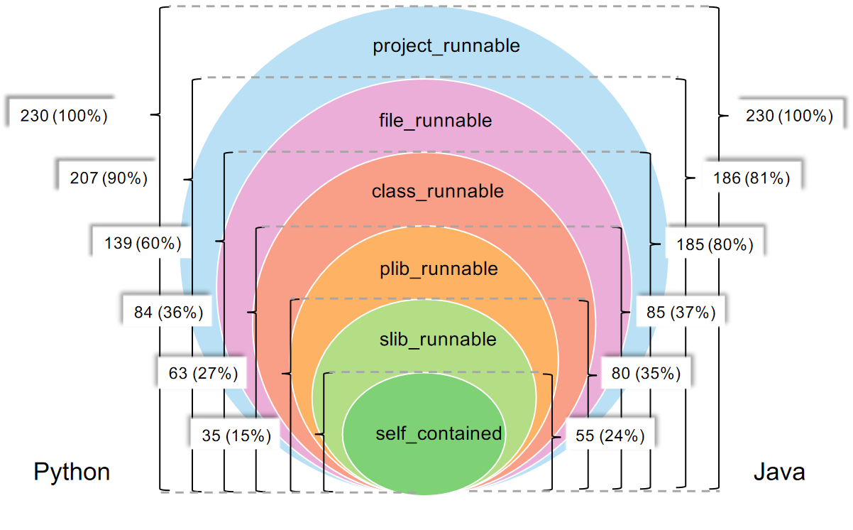
CoderEval Benchmark - Dataset Inspection
Runnable-level Classification.

Slide 13
CoderEval Benchmark - Evaluation Process
We build a ready runtime environment for automatic evaluation based on a Linux Docker image.
Python:
We setup per-project Python environments.
Java:
We ensure that all projects are executable with Java 1.8.

Slide 14
Experiments - Research Questions
How to CodeGen, PanGu-Coder and CodeX perform on CodeEval and HumanEval?
How do different models perform in correctly utilizing the contextual information?
How does the prompt affect the performance of different models?

Slide 15
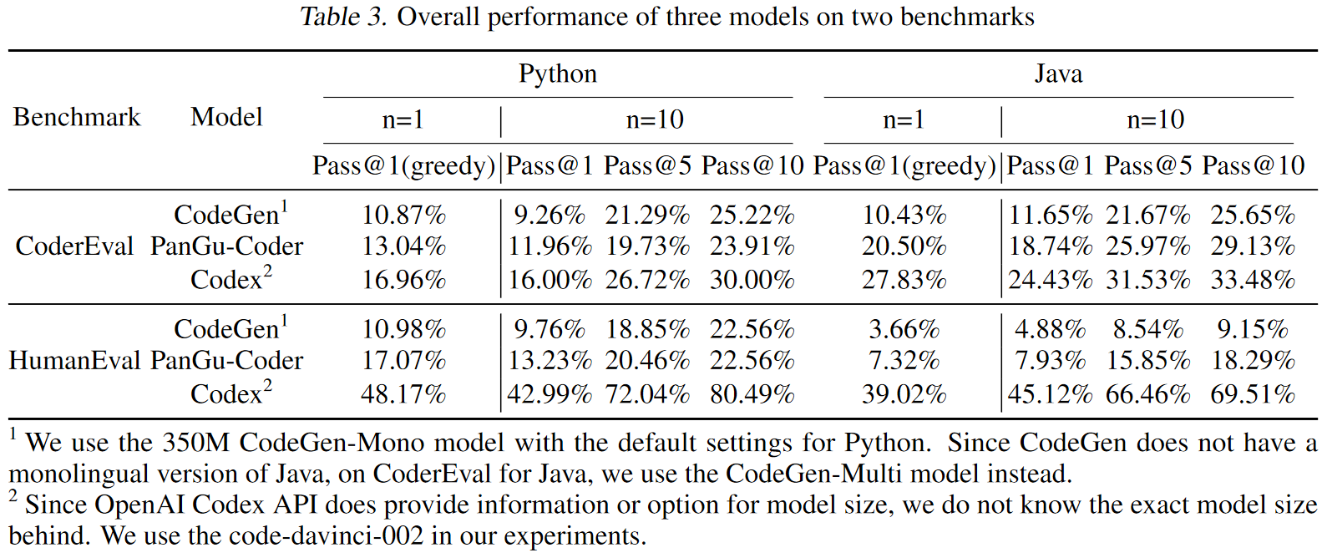
Experiments - RQ1
How to CodeGen, PanGu-Coder and CodeX perform on CodeEval and HumanEval?

Slide 16
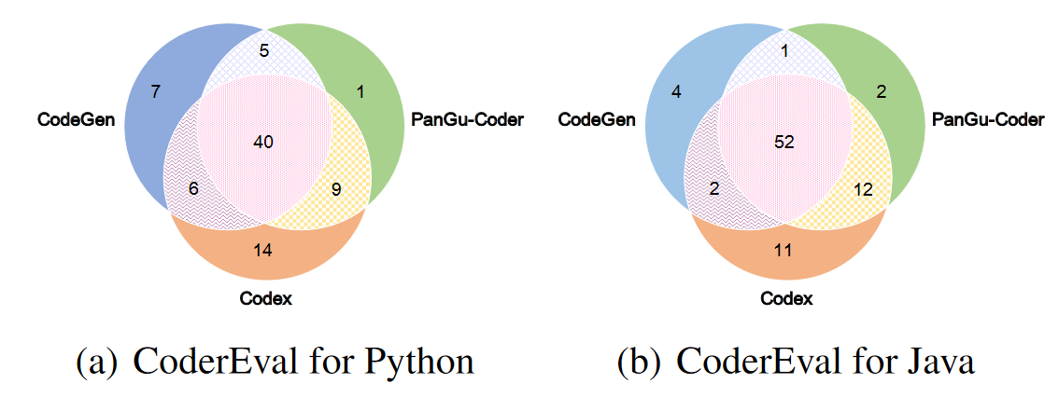
Experiments - RQ1
How to CodeGen, PanGu-Coder and CodeX perform on CodeEval and HumanEval?
Complementarity and intersection of three models.

Slide 17
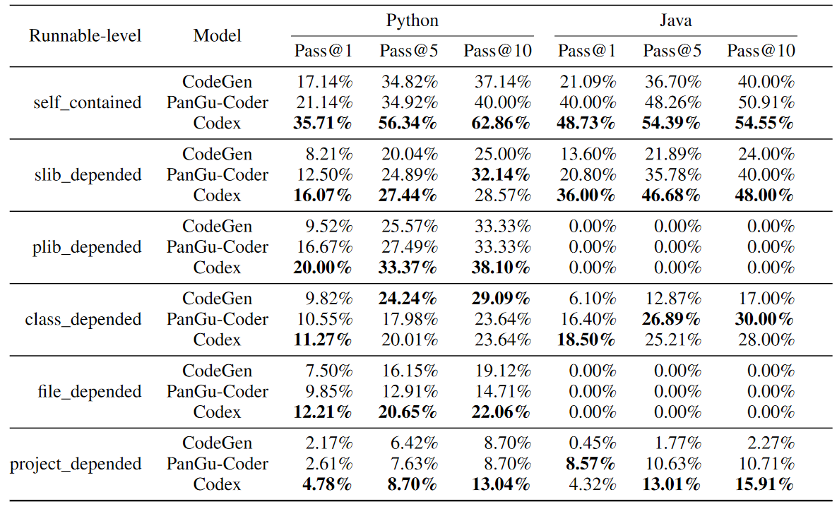
Experiments - RQ1
How to CodeGen, PanGu-Coder and CodeX perform on CodeEval and HumanEval?
Performance comparison between different runnable-levels.

Slide 18
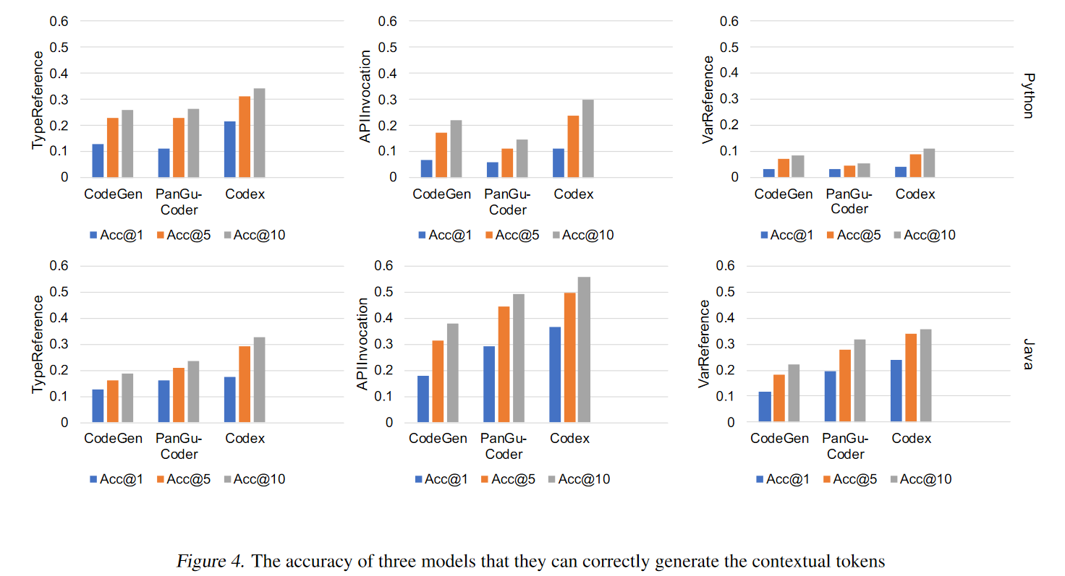
Experiments - RQ2
How do different models perform in correctly utilizing the contextual information?

Slide 19
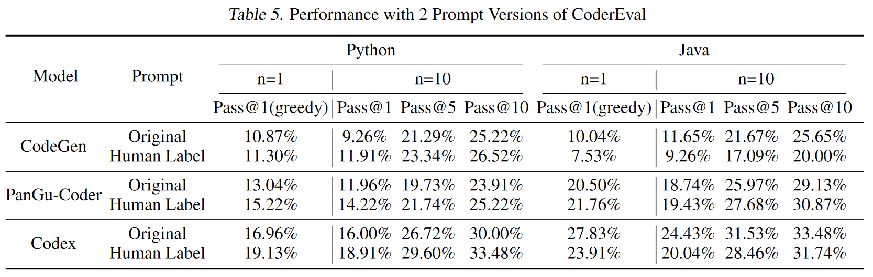
Experiments - RQ3
How does the prompt affect the performance of different models?

Slide 20
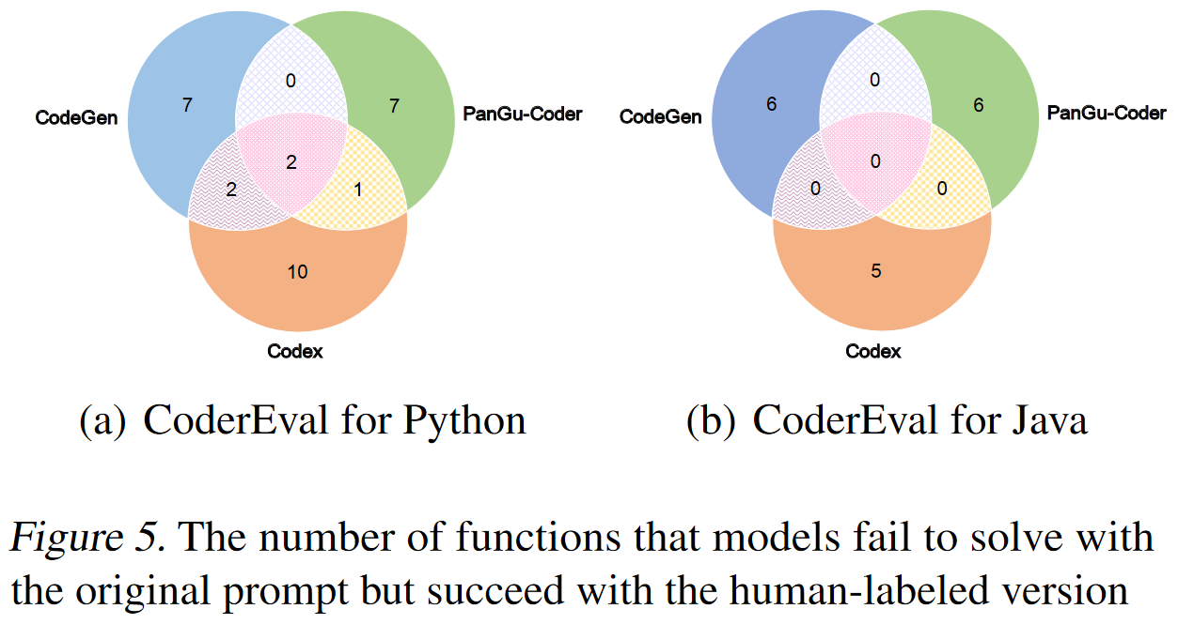
Experiments - RQ3
How does the prompt affect the performance of different models?
Complementarity and intersection of three models.

Slide 21
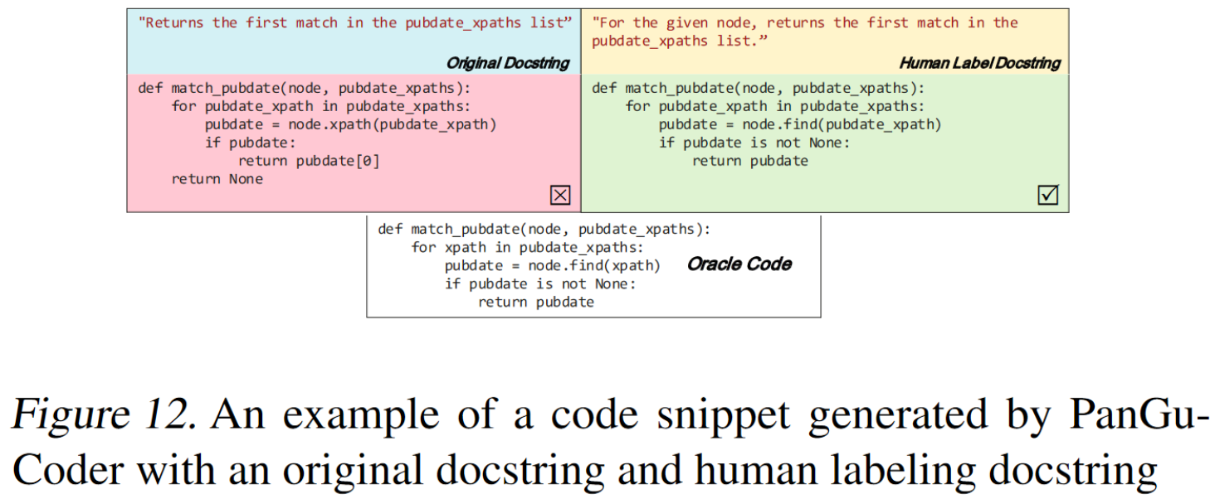
Case Study

Slide 22
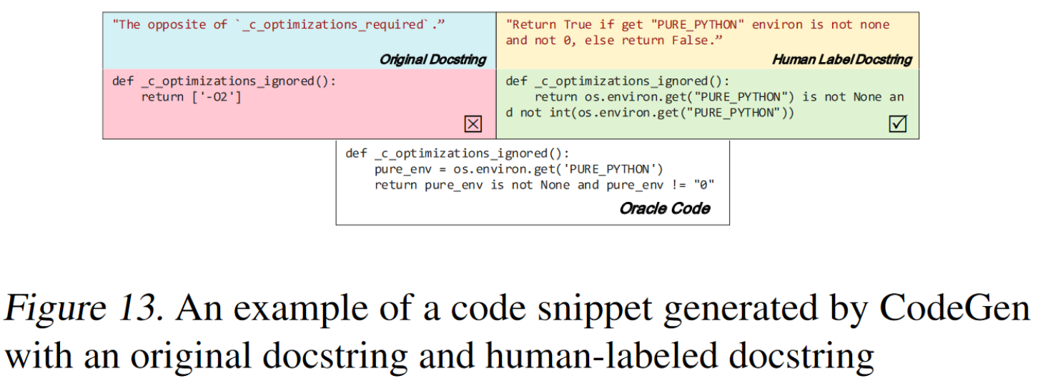
Case Study

Slide 23
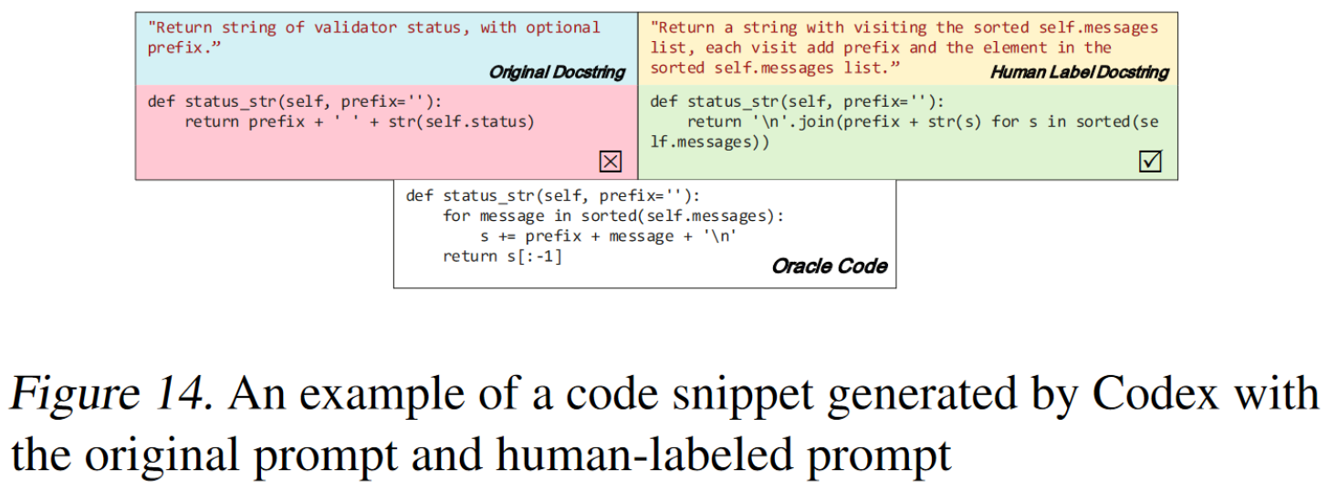
Case Study

